Slide 1
How to Do an Intake for the Neighborhood Christian Legal Clinic
Mr. Brian N. Dunkel
Director of Legal Services
Attorney-at-Law
3333 N. Meridian Street, Suite 201
Indianapolis, IN 46208
www.nclegalclinic.org

Slide 2
Prayer & Introductions
What is your Name?
What is your “day” job?
What intake site do you volunteer at?

Slide 3
Mission of the Neighborhood Christian Legal Clinic
To promote justice through legal representation and education for our low-income neighbors as a way of demonstrating the love of Christ.

Slide 4
Our Vision for Intake
Clients are well-served by accessible and helpful intake sessions.
Clients offered legal information and advice on the spot by the volunteer attorney.
High-quality intakes enable Clinic’s staff attorneys to decide if more service can be offered to the client.

Slide 5
Our Intake Sites
Partner churches and organizations across Indianapolis metro area.
Complete list here: www.nclegalclinic.org/IntakeSchedule.aspx
St. Vincent Primary Care Center Vida Nueva United Methodist Church Nehemiah Bible Church NCLC Main Office, 3333 N. Meridian Aletheia Church First Presbyterian Church of Noblesville John Knox Presbyterian Church | Southeastern Church of Christ La Plaza Shepherd Community Center Zionsville Presbyterian Church First Presbyterian Church of Lebanon

Slide 6
Our Intake Sites
Operate 6 days per week at a variety of times of day.
First come, first served (no appointments)
Each intake session is for up to 4 clients in a 2-hour intake session.

Slide 7
Expectations of Volunteer Attorney
Represent the Clinic in a God-glorifying way.
Notify volunteer coordinator of schedule conflict.
Meet with up to 4 clients in a 2-hour intake session.
Ask good questions, listen well, and take opportunities to encourage client.
Use General Intake Form to submit high-quality intakes and completed Financial Affidavit forms

Slide 8
Income Guidelines
Legal representation: household income is at or below 125% of federal poverty guidelines.
Low-income Taxpayer Clinic: household income at or below 250% of federal poverty guidelines
Housing counseling program: no income guidelines
Consult pg. 5 of Intake Guide, but income eligibility is determined by staff not volunteers
Make sure they complete Financial Affidavit!

Slide 9
Case Types We Do Not Take
Family Law (discussed more on next slide)
Criminal prosecution
Fee-generating
Class action
Social Security Disability (SSD) appeals
Personal injury
Worker’s compensation
Employment discrimination
Housing discrimination
Civil rights issues
School/education law

Slide 10
Family Law Issues
No legal representation in family law cases (but guardianship as resources allow)
No longer offering Project PEACE – free family law mediation
Offer information/advice on spot (if competent)
Other civil legal aid providers provide legal representation
Domestic Violence Screening Tool (pg. 11)

Slide 11
How to Submit an Intake
Using the General Intake Form:
www.nclegalclinic.org/Management/YellowForm.aspx
No handwriting allowed!

Slide 12
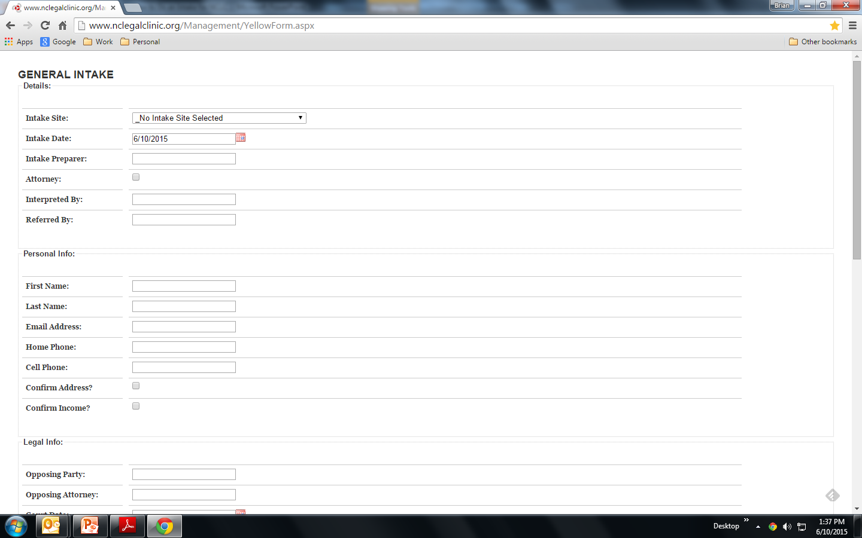
How to Submit an Intake (cont’d)

Slide 13
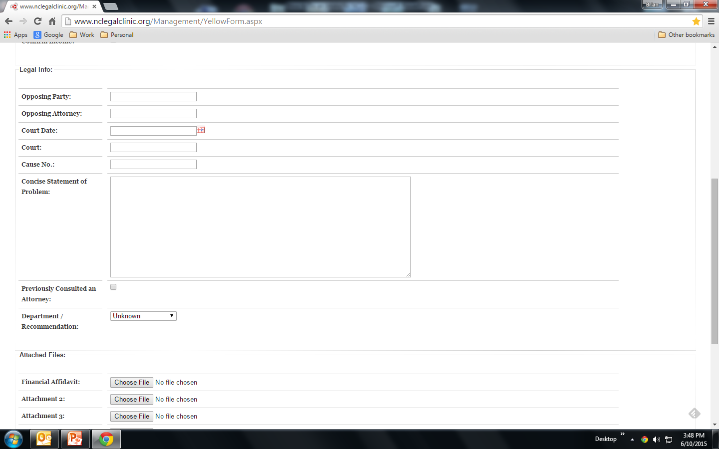
How to Submit an Intake (cont’d)

Slide 14
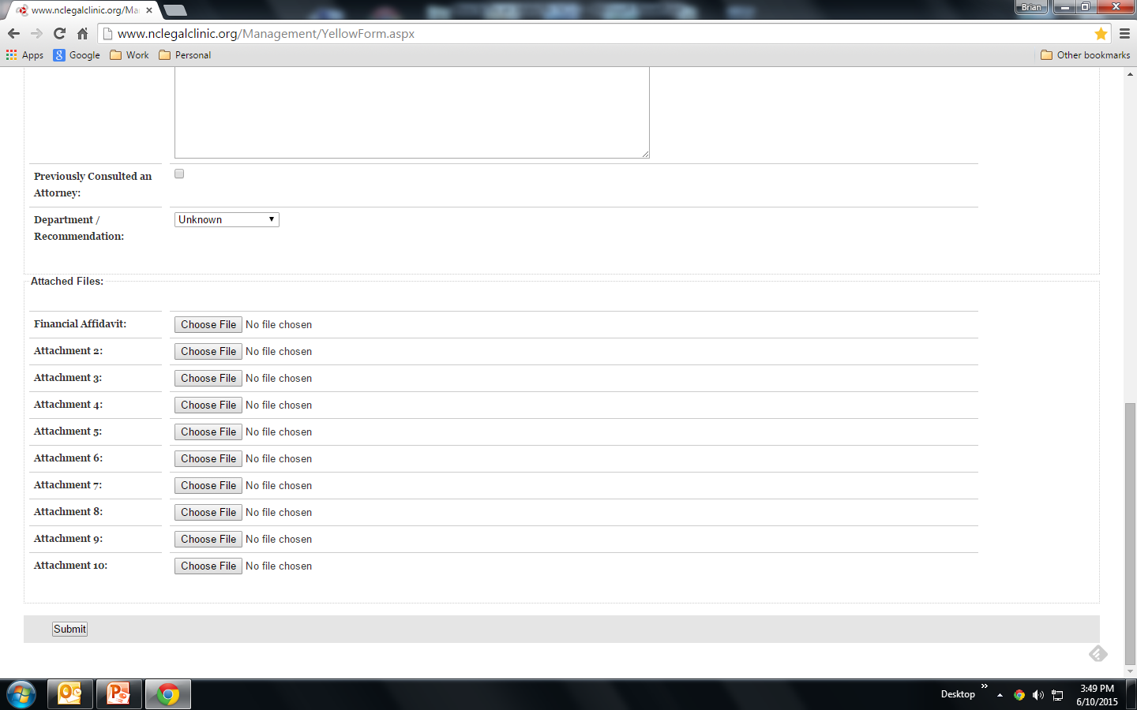
How to Submit an Intake (cont’d)

Slide 15
How to Scan Documents
Use the scanner at the intake site.
*Scanner demonstration*
If you have problems with this, please email a PDF of completed Financial Affidavit forms and relevant documents to the Clinic’s volunteer coordinator within 24 hours of the intake session.

Slide 16
What to Tell Client to Expect
During intake: may be able to offer legal advice and information
After intake: Client will receive letter or phone call from one of Clinic’s attorneys in 2 to 4 weeks to let you know if the Clinic can offer additional advice, and in limited cases, representation.
See sample transcript, Intake Guide, pg. 9.

Slide 17
Encouraging Someone at Intake
Share the promises of God in Jesus Christ. See Intake Guide, page 10.
Offer to pray with client.
Tell client you will pray for him or her after intake (and actually do it!).
Connect client with the church or ministry staff/volunteer at the intake site (if that has not already happened).

Slide 18
Immigration (pgs. 12-15)
What does the immigrant want to accomplish?
I want to:
Get my green card
Apply for citizenship (naturalization)
See if I qualify for a victim’s visa (U-Visa)
Bring my family to the United States
See if I qualify for Deferred Action for Childhood Arrivals (DACA)

Slide 19
Immigration (pgs. 12-15)
I am afraid to go back to my country.
I am not sure what kind of help I need.

Slide 20
Housing (pgs. 16-17)
Landlord-Tenant
Mortgage Foreclosure
Clinic is HUD-approved housing counseling agency and member of Indiana Foreclosure Prevention Network (IFPN).

Slide 21
Tax (pg. 18)
Source of tax problem
Letters from IRS
Alleged tax debt
Disputed tax debt?
Need help dealing with undisputed tax debt?
Tax identity theft/tax preparer fraud
Innocent spouse/injured spouse relief

Slide 22
Expungement (pgs. 19-20)
Why are you seeking an expungement?
Date of most recent conviction in Indiana?
Arrests not leading to conviction?
Pending criminal charges in any state?
Year, county, type of conviction, and offense?
Convictions outside of Indiana?
Proof that fines, court costs, restitution are paid?
Documents to ask about:
Record from Indiana State Police or local police?
Chronological case summaries?

Slide 23
Expungement (pg. 21)
Project GRACE’s Expungement Help Desk
Provides legal information and assistance in filling out forms.
Only Wednesdays, Thursdays, Fridays
9:00 a.m. to 4:00 p.m.
Room G-25* of City-County Building
(*Moving to B-2 in early 2017)
Call (317) 429-4131, ext. 164 for weekly hours.

Slide 24
Bankruptcy (pgs. 22-23)
Prior bankruptcy filing?
Debts
Assets
Income
Status of debt collection efforts?
Advice on being “judgment proof” (Intake Guide, p. 23)

Slide 25
Debt Collection (pgs. 24-26)
Debts
Assets
Income
Status of debt collection efforts?
Lawsuit
Judgment entered against debtor
Wage garnishment

Slide 26
Driver’s License (pgs. 27-28)
Status of driving privileges in Indiana?
Common active suspensions
Specialized driving privileges
Indiana driver record on BMV website

Slide 27
Guardianship (pg. 29-30)
(Questions for a proposed guardian)
Who do you want guardianship of?
Relationship to proposed ward?
Reason for guardianship?
Questions regarding minor ward
Assets?
Will or POA?
Will anyone contest guardianship?

Slide 28
Will & Estate Planning (pg. 31)
Type of document(s) client is seeking?
Family situation?
Assets?
Responsible parties?

Slide 29
Other Resources (pg. 32)
Connect2Help 2-1-1
Indiana Legal Services
Indianapolis Legal Aid Society
Julian Center

Slide 30
Interested in Volunteering?
Kathleen Bloxsome
Volunteer Coordinator
Neighborhood Christian Legal Clinic
3333 N. Meridian Street, Suite 201
Indianapolis, IN 46208
(317) 429-4131, ext. 161
kbloxsome@nclegalclinic.org

Slide 31
Questions?
Mr. Brian N. Dunkel
Director of Legal Services
Attorney-at-Law
Neighborhood Christian Legal Clinic
3333 N. Meridian Street, Suite 201
Indianapolis, IN 46208
(317)429-4134
bdunkel@nclegalclinic.org

